Slide 1
Deep Learning
Elizabeth Doria Rosales [212737]
Yosleny Leal Echevarria [214180]
Notes:
© Copyright PresentationGO.com – The free PowerPoint and Google Slides template library

Slide 2
Next Value prediction
Given a dataset with 3 features: x, y, and z representing the acceleration collected from individuals by a wearable device. Create a model to predict the next value in a sequence of values.
Notes:
© Copyright PresentationGO.com – The free PowerPoint and Google Slides template library

Slide 3
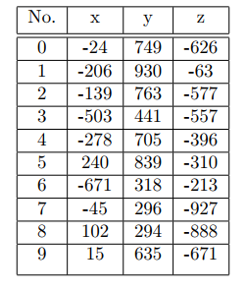
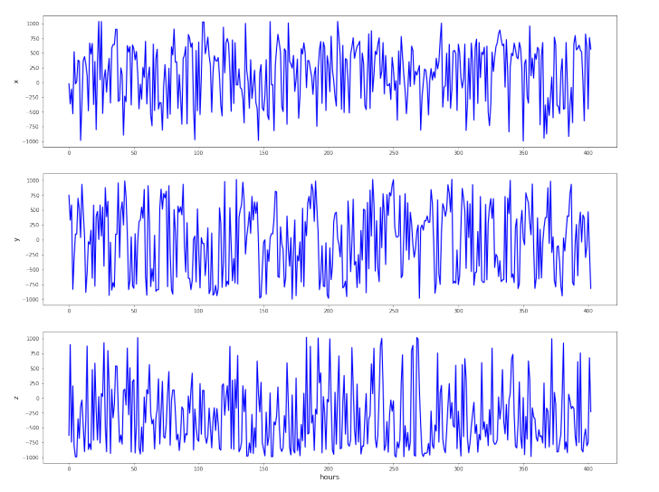
Data Understanding
Dataset extract:
Time evolution of these features:
Notes:
© Copyright PresentationGO.com – The free PowerPoint and Google Slides template library

Slide 4
Data Preparation
No missing values
Data splitting: 80% for training and 20 for validation
Data normalization using min-max scaler with values (-1, 1)
Data windowing based on window_size = 30 and the window_shift = 6 to represent given a sequence of 5 minutes predict every 1 minute each feature(x, y, z)
Notes:
© Copyright PresentationGO.com – The free PowerPoint and Google Slides template library

Slide 5
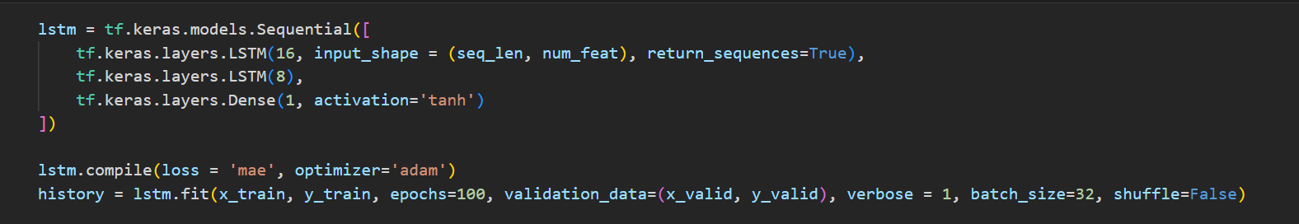
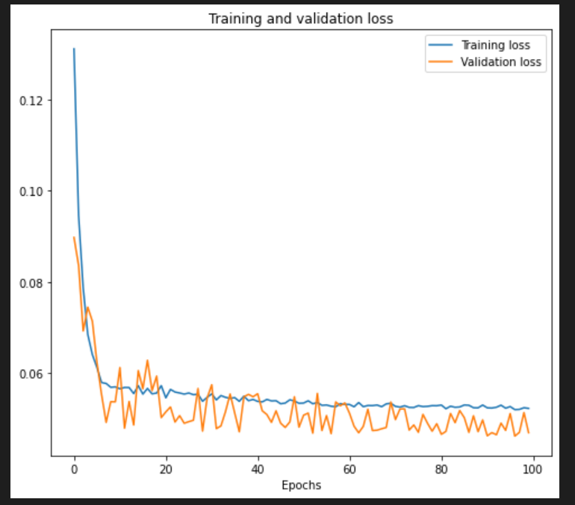
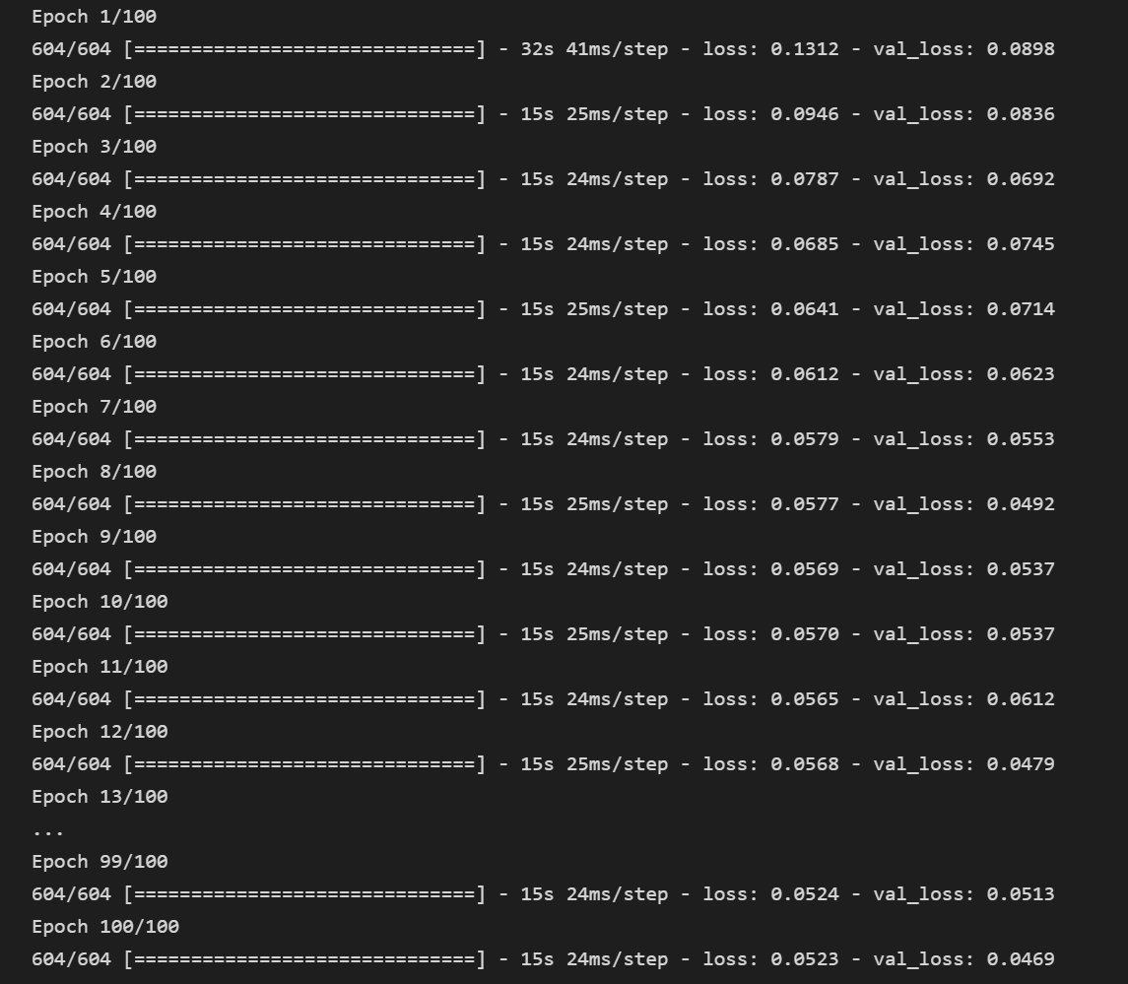
Data Modeling
Notes:
© Copyright PresentationGO.com – The free PowerPoint and Google Slides template library

Slide 6

Data Prediction
Results by using window_size = 30 window_shift = 6
Notes:
© Copyright PresentationGO.com – The free PowerPoint and Google Slides template library

Slide 7
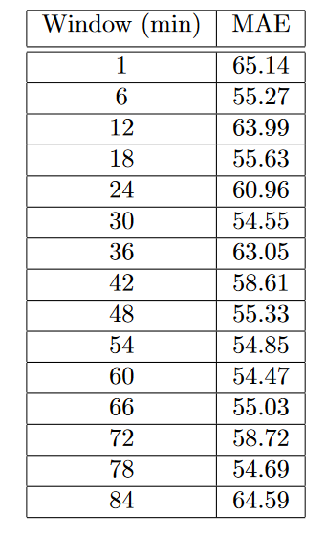
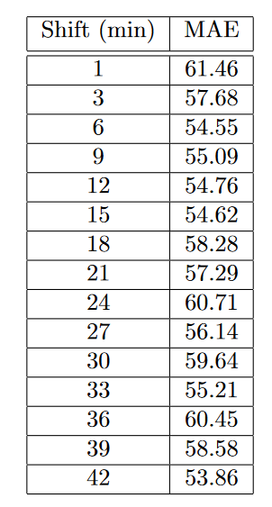
Data Prediction
Selecting feature x, with different window_size and window_shift:
Notes:
© Copyright PresentationGO.com – The free PowerPoint and Google Slides template library

Slide 8
Anomaly Detection
Given a dataset for data collected from patients by a wearable device, create a model to identify anomalous events.
Notes:
© Copyright PresentationGO.com – The free PowerPoint and Google Slides template library

Slide 9
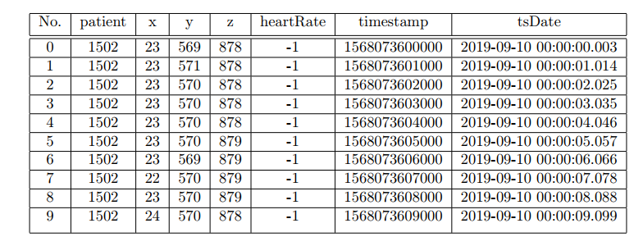
Data Understanding
Dataset extract:
Notes:
© Copyright PresentationGO.com – The free PowerPoint and Google Slides template library

Slide 10
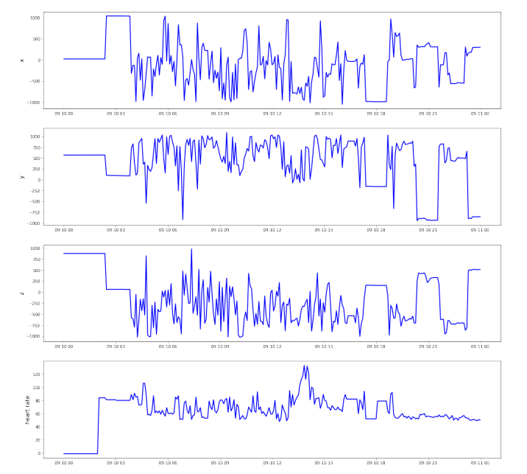
Data Understanding
Time evolution of the acceleration component and heart rate:
Notes:
© Copyright PresentationGO.com – The free PowerPoint and Google Slides template library

Slide 11
Data Preparation
Missing values for the heart rate feature are replaced with the median value
Data splitting: 80% for training and 20 for validation
Data normalization using min-max scaler with values (-1, 1)
Feature engineering: x, y, z, heartRate
Notes:
© Copyright PresentationGO.com – The free PowerPoint and Google Slides template library

Slide 12
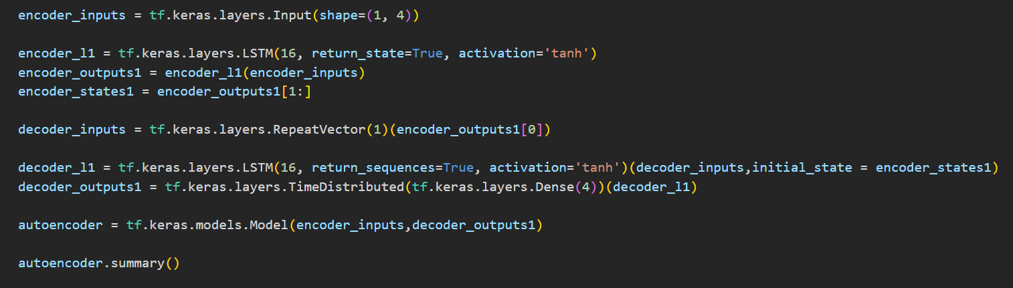
Data Modeling
Reconstruction-based approach
Notes:
© Copyright PresentationGO.com – The free PowerPoint and Google Slides template library

Slide 13
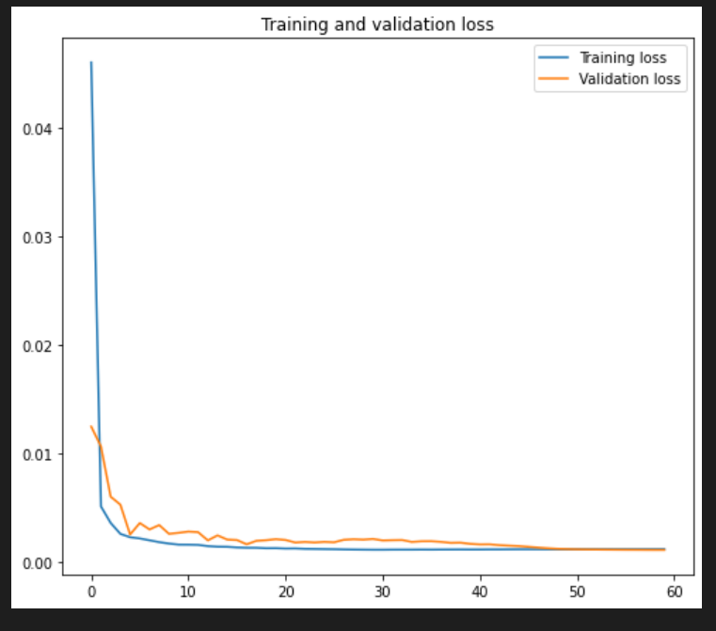
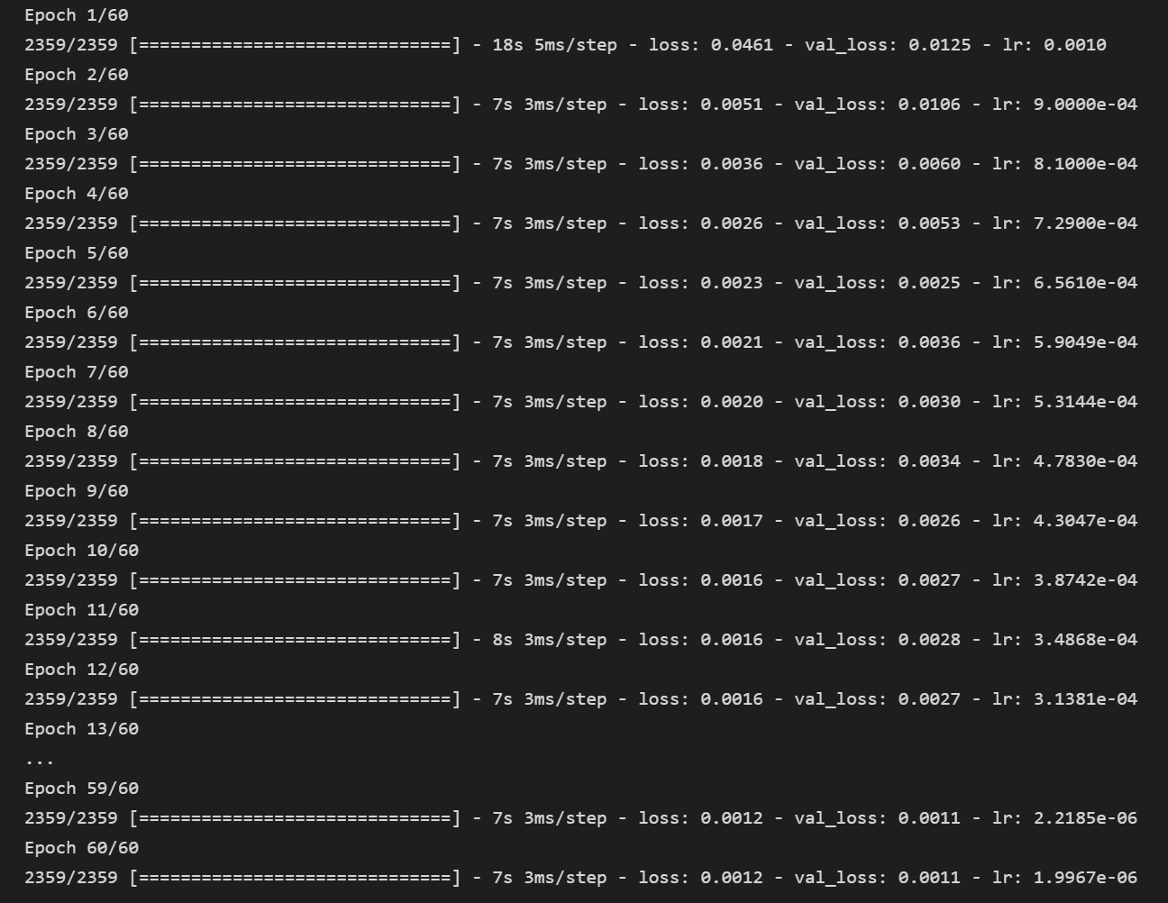
Data Modeling
Notes:
© Copyright PresentationGO.com – The free PowerPoint and Google Slides template library

Slide 14
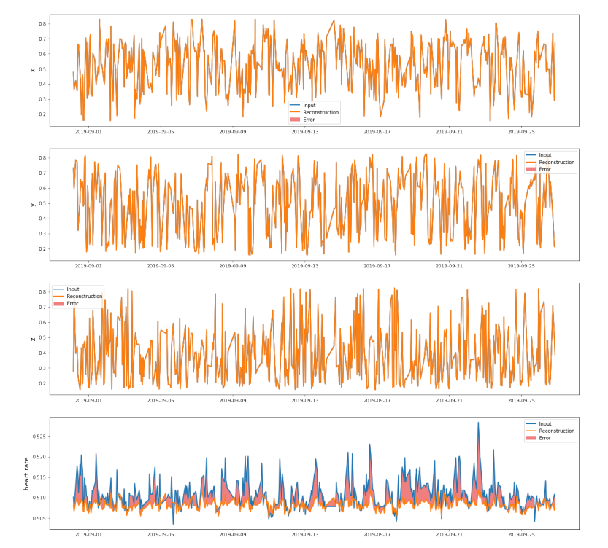
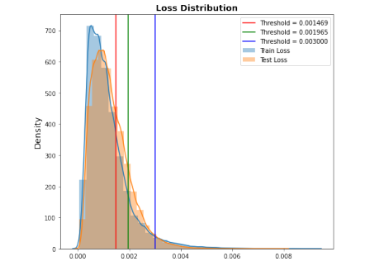
Data reconstruction
Notes:
© Copyright PresentationGO.com – The free PowerPoint and Google Slides template library

Slide 15
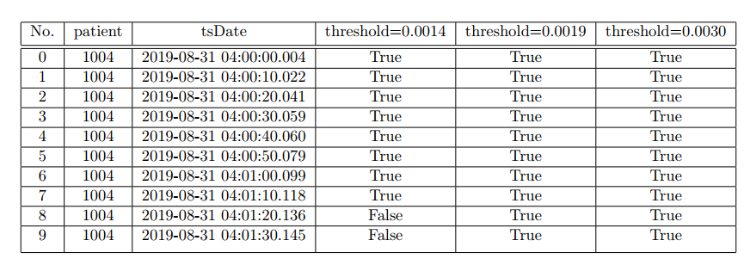
Data reconstruction
Notes:
© Copyright PresentationGO.com – The free PowerPoint and Google Slides template library

Slide 16
Thank you

